Slide 1

Logistics & Inventory Management
Team - ISecG7

Slide 2
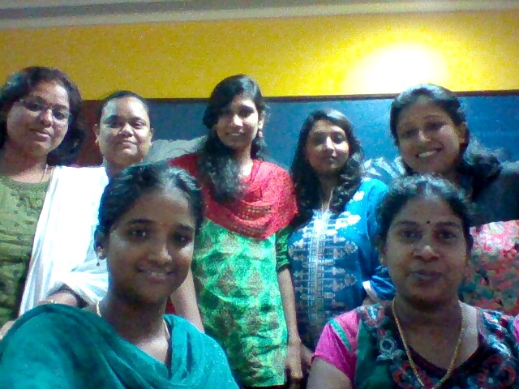
Team ISecG7
Ravali Poondla
Roopa Rao
Asha R
Pavithra Madhavan
Monica Francis Selvaraj
Annapoorani Natarajan
Raumya Rakeshwari

Slide 3

Motive
We wanted to be associated with some social cause and do a bit from our side. This great quote rightly depicts our motive.

Slide 4
Reasons behind technologies used
REST API
Useful for restricted-profile devices such as mobile and PDAs
Can be accessed easily from multiple platforms/languages
HTML/JQuery
Responsive web design
Simplicity
Lack of native mobile skill set
SQL Server
Ease of use using Microsoft Entity Data Model

Slide 5
WebApp Usability
Responsive design
No hidden navigation, for ease of use
SVG icons used as they are lightweight and scale extremely well when resized
Color combinations tested for accessibility
Retained uniformity across all flows so that learnability is not an issue
Simplified to basic requirement, customizable for more features

Slide 6
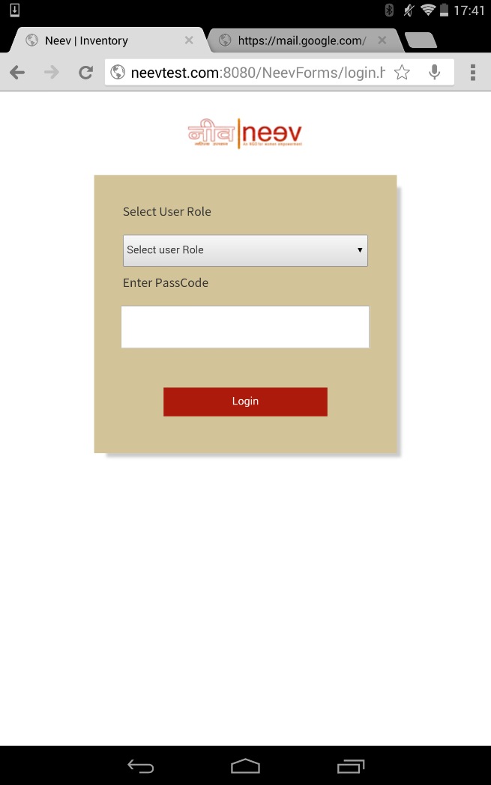
Screenshots : Login Screen

Slide 7
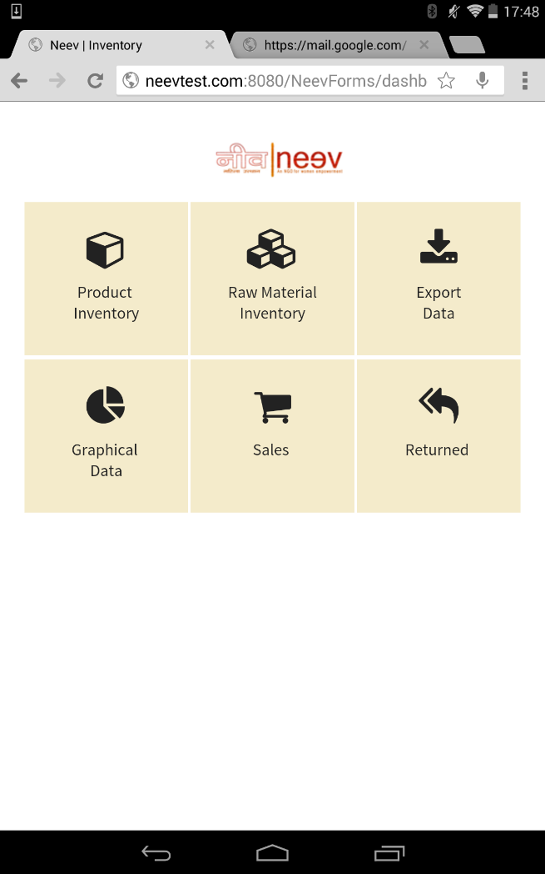
Screenshots : Dashboard

Slide 8
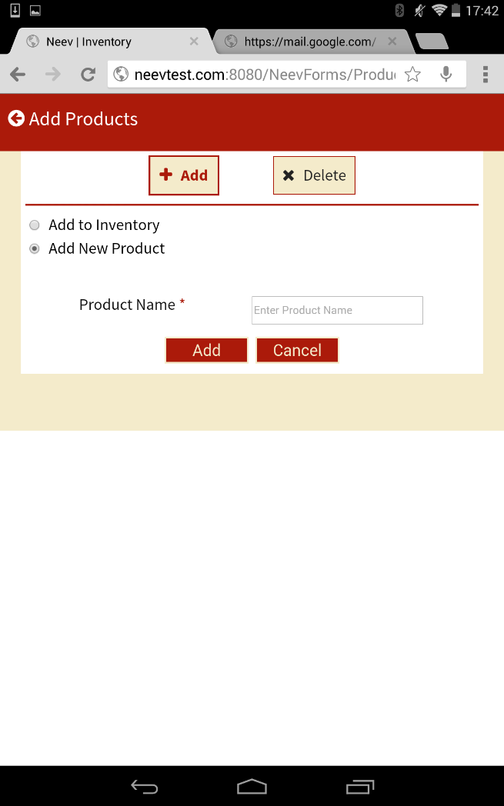
Screenshots : Add New Product

Slide 9
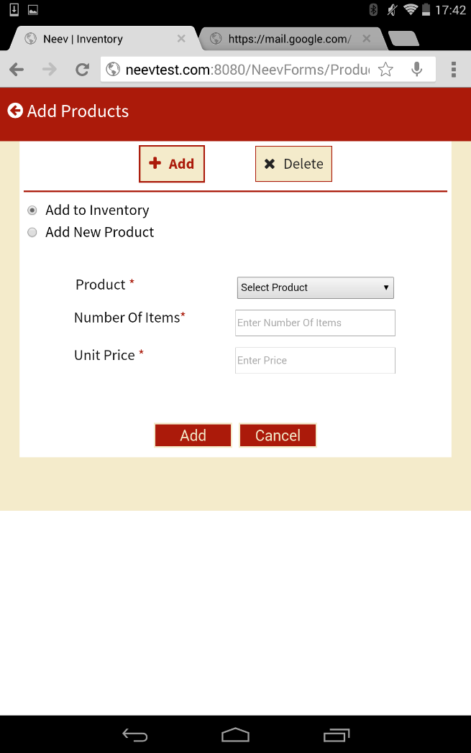
Screenshots : Add Product to Inventory

Slide 10
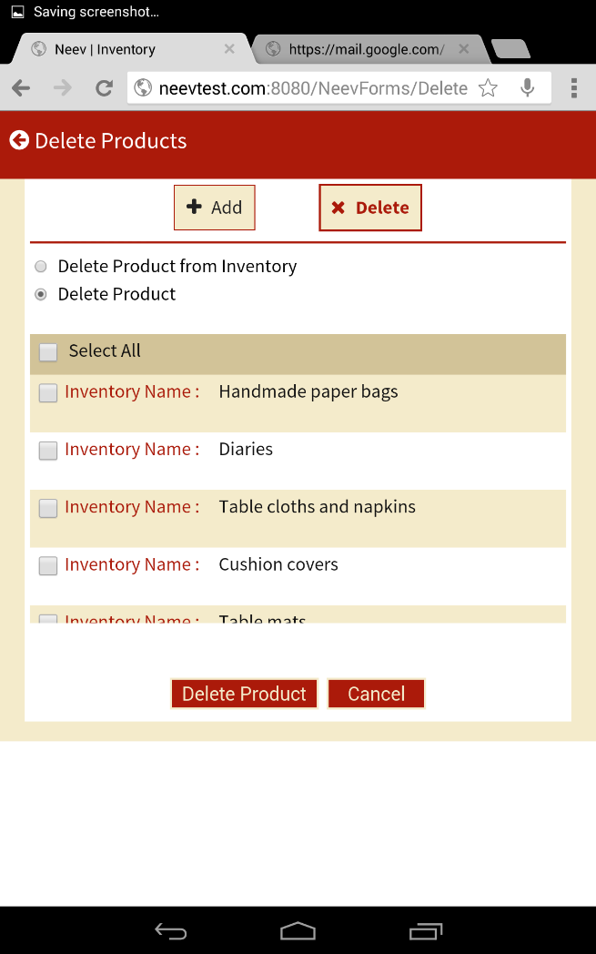
Screenshots : Delete Product

Slide 11
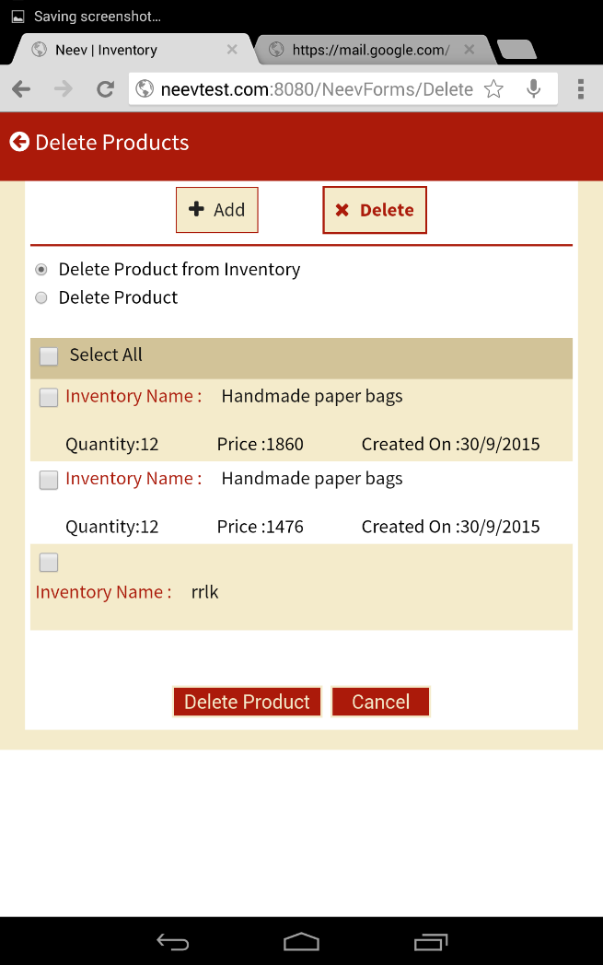
Screenshots : Delete Product from Inventory

Slide 12
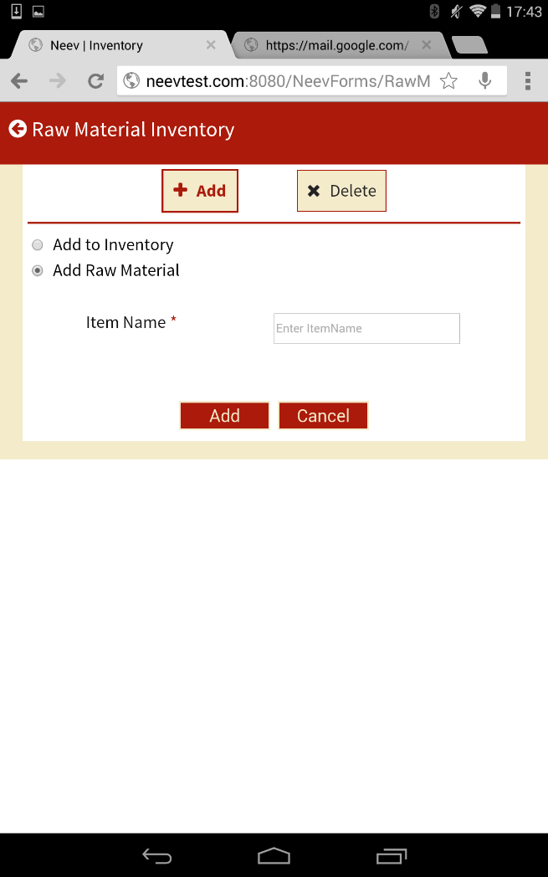
Screenshots : Add New Raw Material

Slide 13
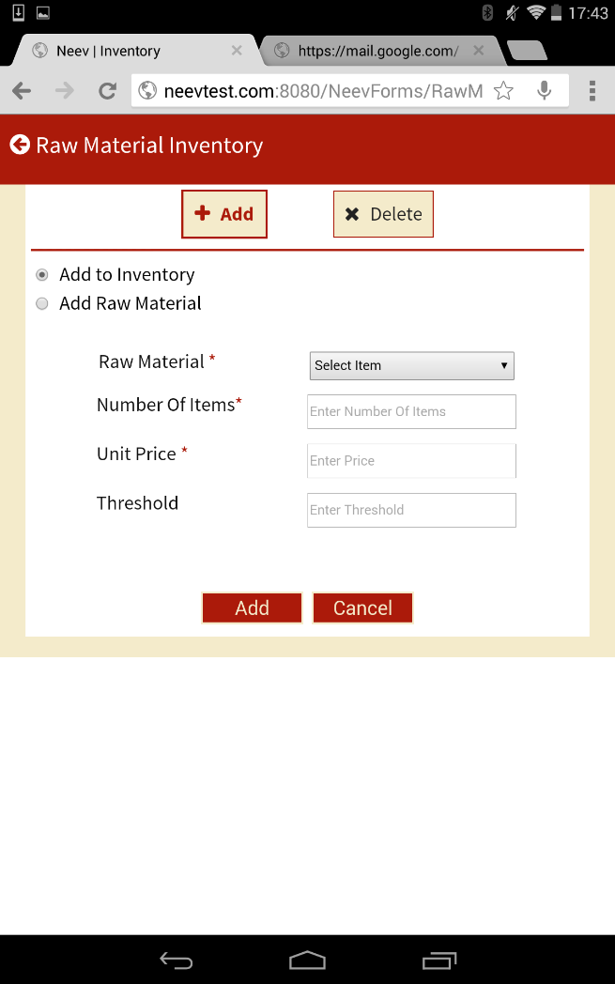
Screenshots : Add Material to Inventory

Slide 14
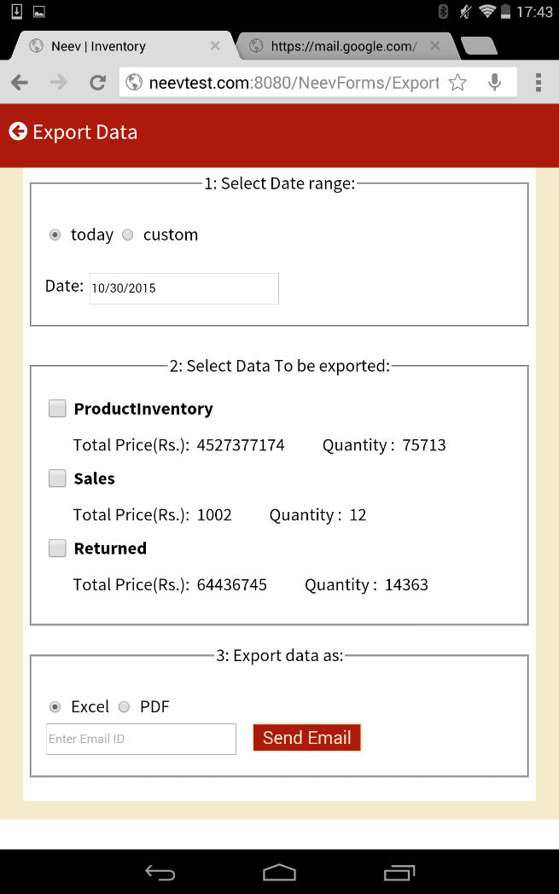
Screenshots : Export Data

Slide 15
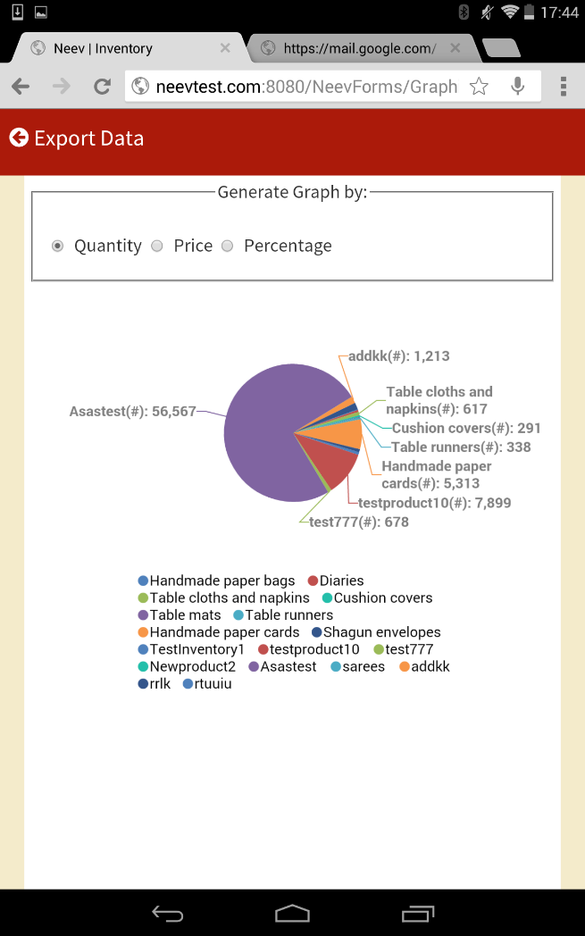
Screenshots : Generate Charts

Slide 16
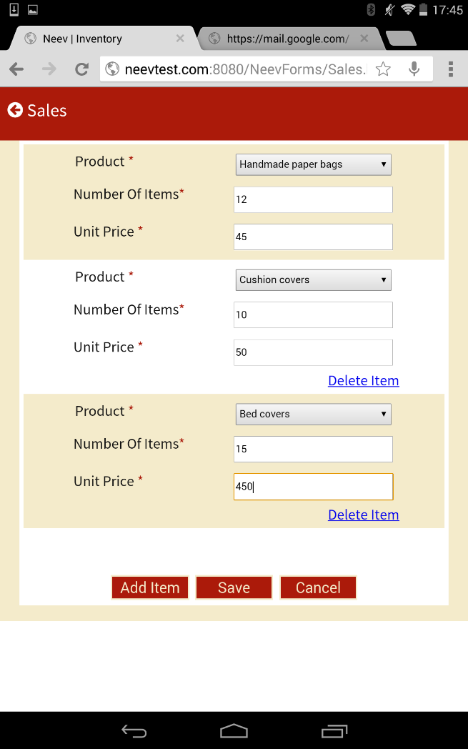
Screenshots : Sales

Slide 17
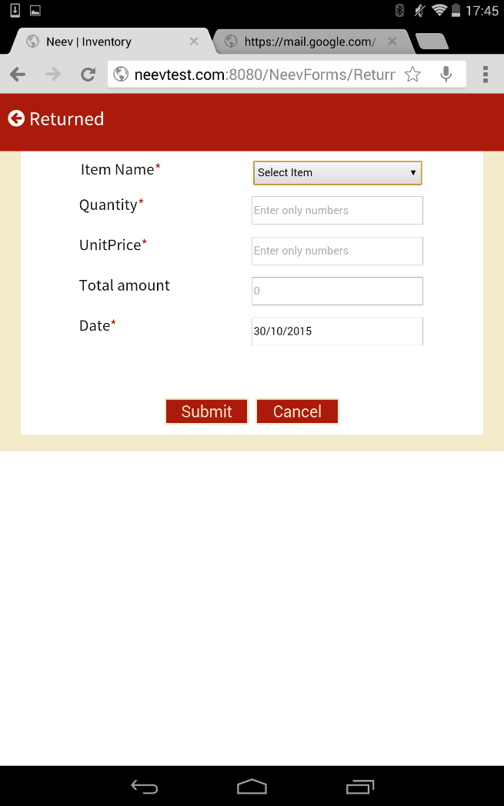
Screenshots : Returned Goods

Slide 18
Setup Instructions :
Rest API is hosted at: http://neevtest.com:8080/InventoryAPI/help
Passcode for CXO view: 1234
Github URL: https://github.com/ravalipoondla/NeevApplicationbyISecG7
Demo Video : https://drive.google.com/file/d/0B4ElRFTt0gAEejFpWXF5dUozbjQ/view?usp=sharing

